Slide 1
Storage Latency

Slide 2
CPU
Storage
A
A
C
C
=
*
B
B

Slide 3
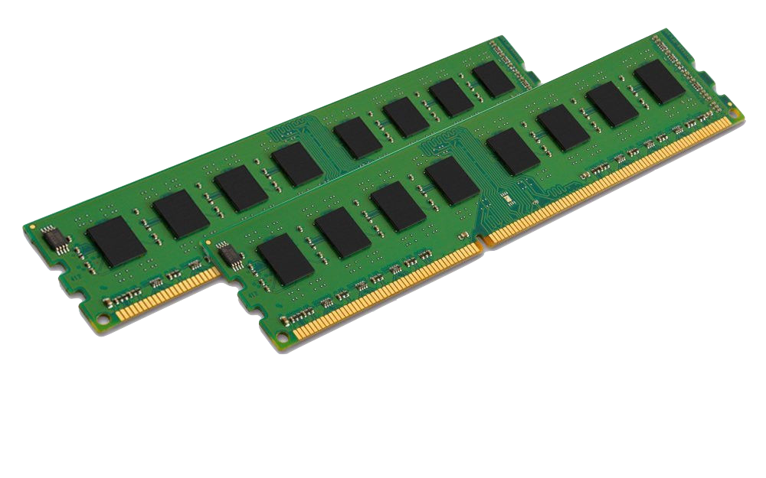
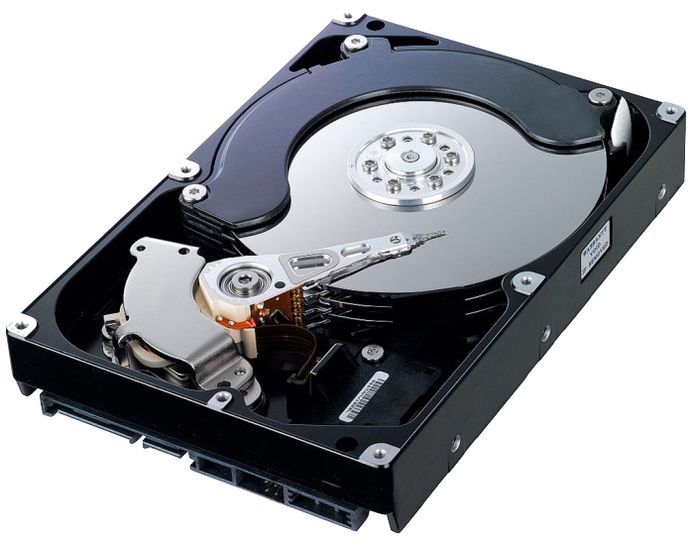
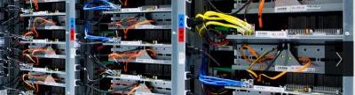
Latencies
Storage Types
Read A
Read B
C=A*B
Write C
With big data, most of the latency is memory latency (1,2,4), not computation (3)
Main Memory (RAM)
Spinning disk
Remote computer
Latency 1
Total Latency
Latency 2
TIME
Latency 3
Latency 4

Slide 4
Summary
The major source of latency in data analysis is reading and writing to storage
Different types of storage offer different latency, capacity and price.
Big data analytics revolves around methods for organizing storage and computation in ways that maximize speed while minimizing cost.
Next, storage locality.

